Slide 1
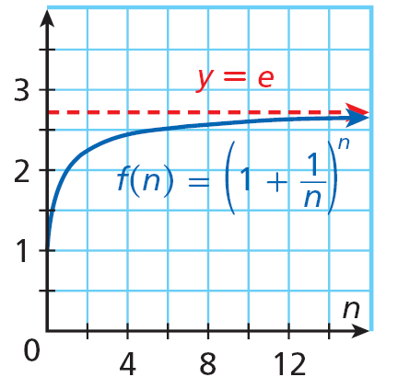
As n gets very large, interest is continuously compounded. Examine the graph of f(n)=
(1 + )^{n}. The function has a horizontal asymptote. As n becomes infinitely large, the value of the function approaches approximately 2.7182818…. This number is called e. Like π, the constant e is an irrational number.
1
n

Slide 2
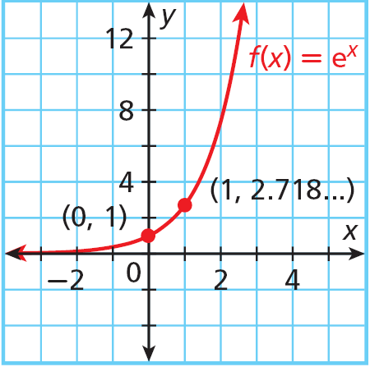
Exponential functions with e as a base have the same properties as the functions you have studied. The graph of f(x) = e^{x} is like other graphs of exponential functions, such as f(x) = 3^{x}.
The domain of f(x) = e^{x} is all real numbers. The range is {y|y > 0}.

Slide 3
Caution
The decimal value of e looks like it repeats: 2.718281828… The value is actually 2.71828182890… There is no repeating portion.

