Slide 1
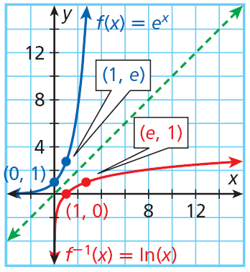
A logarithm with a base of e is called a natural logarithm and is abbreviated as “ln” (rather than as log_{e}). Natural logarithms have the same properties as log base 10 and logarithms with other bases.
The natural logarithmic function f(x) = ln x is the inverse of the natural exponential function f(x) = e^{x}.

Slide 2
The domain of f(x) = ln x is {x|x > 0}.
The range of f(x) = ln x is all real numbers.
All of the properties of logarithms from Lesson 7-4 also apply to natural logarithms.

Slide 3
Example 2: Simplifying Expression with e or ln
Simplify.
A. ln e^{0.15t}
B. e^{3ln(x +1)}
ln e^{0.15t} = 0.15t
e^{3ln(x +1)} = (x + 1)³
C. ln e^{2x} + ln e^{x}
ln e^{2x} + ln e^{x} = 2x + x = 3x

Slide 4
Check It Out! Example 2
Simplify.
a. ln e^{3.2}
b. e^{2lnx}
ln e^{3.2} = 3.2
e^{2lnx} = x²
c. ln e^{x +4y}
ln e^{x + 4y} = x + 4y

Slide 5
The formula for continuously compounded interest is A = Pe^{rt}, where A is the total amount, P is the principal, r is the annual interest rate, and t is the time in years.

Slide 6
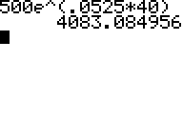
Example 3: Economics Application
What is the total amount for an investment of $500 invested at 5.25% for 40 years and compounded continuously?
A = Pe^{rt}
A = 500e^{0.0525(40)}
Substitute 500 for P, 0.0525 for r, and 40 for t.
A ≈ 4083.08
Use the e^{x} key on a calculator.
The total amount is $4083.08.

Slide 7
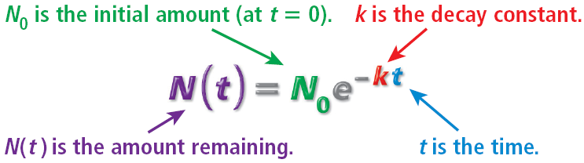
The half-life of a substance is the time it takes for half of the substance to breakdown or convert to another substance during the process of decay. Natural decay is modeled by the function below.

