Slide 1
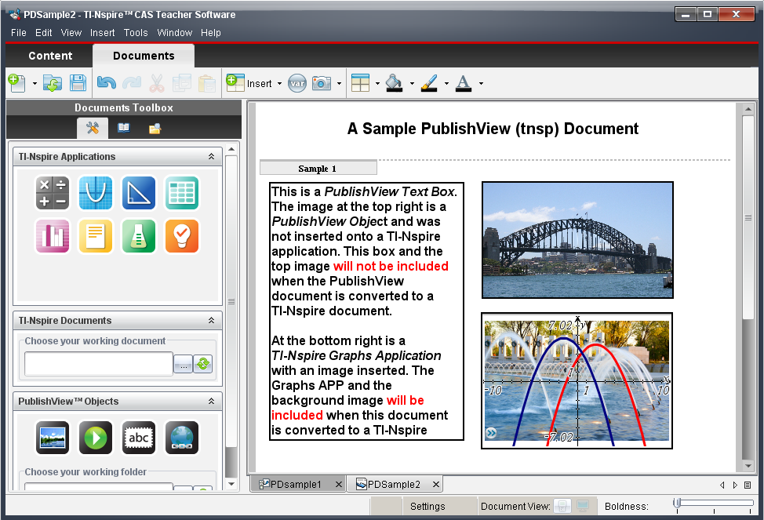
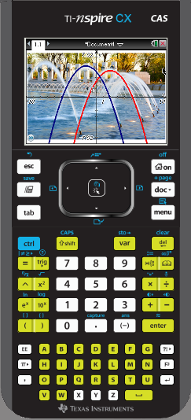
TI-Nspire™ Teacher Software
TI PublishView

Slide 2
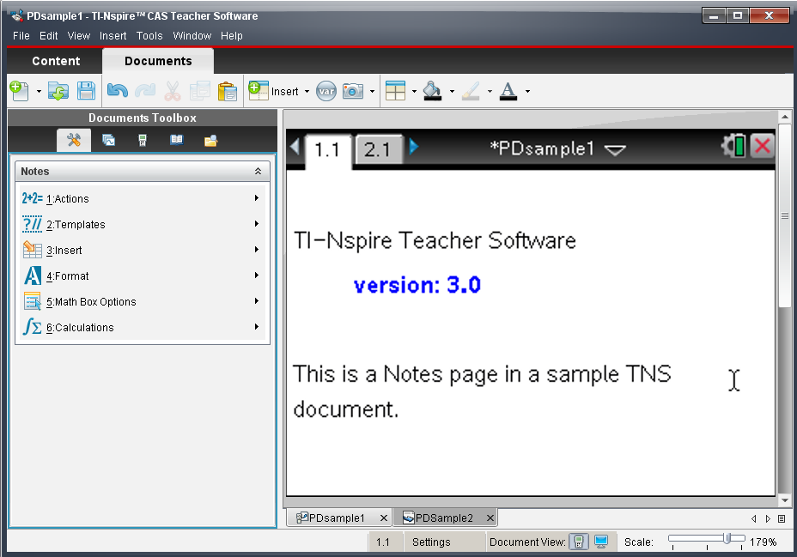
A TI-Nspire document (a tns file)

Slide 3
What is PublishView?
The new PublishView feature allows you to create an interactive worksheet using TI‐Nspire content.
The worksheet can be formatted like a regular sheet of paper containing interactive TI-Nspire applications, richly‐formatted text, video and images.
A TI-Nspire document may be converted to PublishView format and conversely. However, anything you add to a PublishView document that is not supported by the TI-Nspire document (like free floating images and rich text) will not be converted.

Slide 4
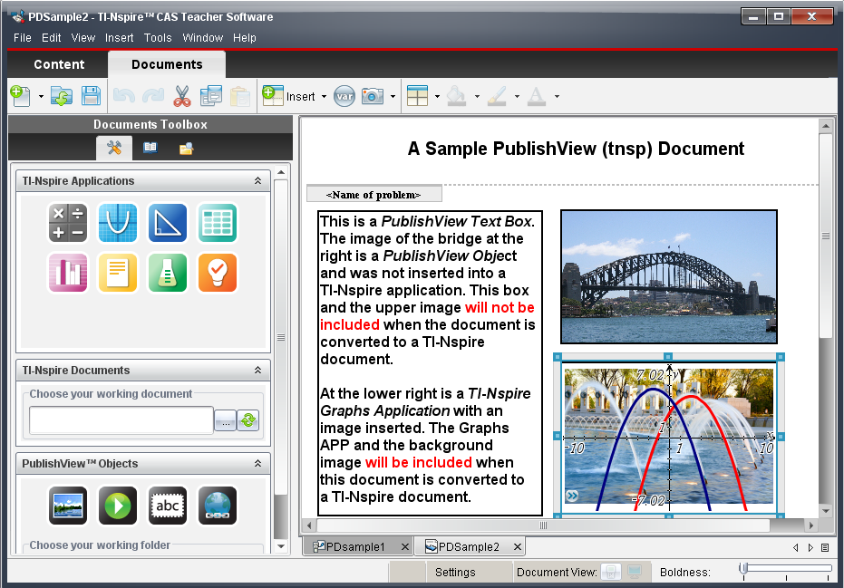
A PublishView document (a tnsp file)
You can drag and drop these icons onto the document page to insert new instances of the application anywhere on the page. You can also re-use pages from an existing TI-Nspire document.e‐use pages from.

Slide 5
Nspired
Learning
Engage
Interact
Communicate
Connect
Apply

