Slide 1
TI-Nspire™ Technology v. 3.0 Release
Math Improvements
February 2011

Slide 2
New Math Functionality
  Modeling on background image
  Exact values and linking in Graphs and Geometry applications
  Improved math results in CAS platform
  Categorical data improvements in Data & Statistics application
  Differential Equation Graphing
  3D Graphing

Slide 3
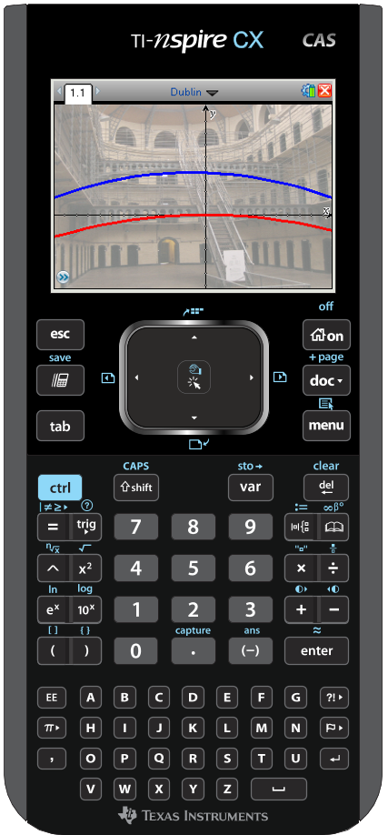
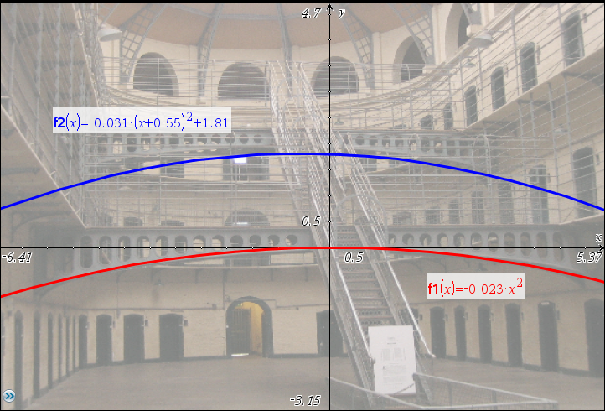
Modeling on Background Image
Images jpg, bmp, png or clipboard
Background Image – Graphs, Geometry, Data & Statistics
Inline with text – Questions, Notes

Slide 4
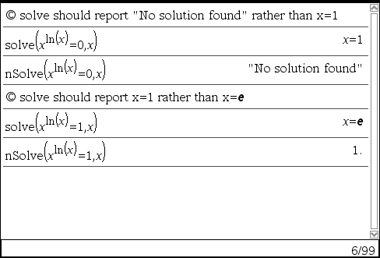

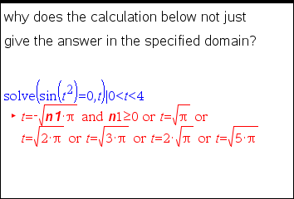
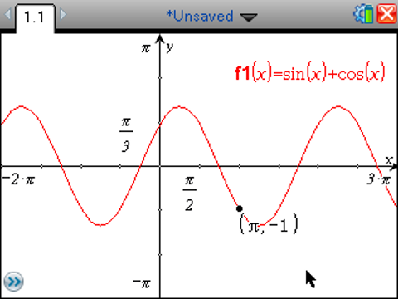
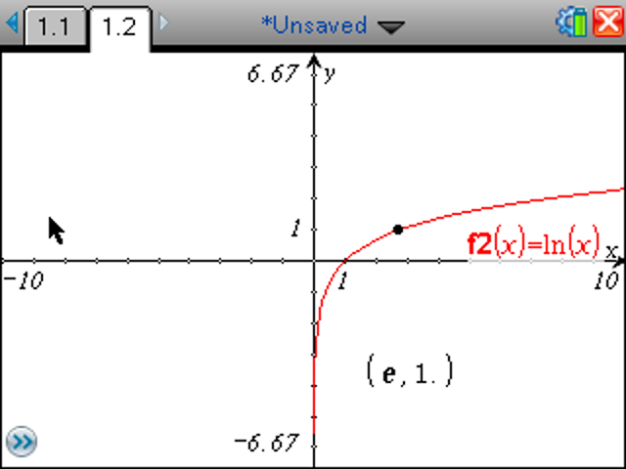
Improved Math Results
X
Algebra
Improvements to simplification, solving equations, inequalities and systems of equations
Calculus
Improvements to series, limits, integrals, derivatives and differential equations. Calculations with Piecewise Functions. Calculations in Approximate Mode.
Graph & Geometry
Exact arithmetic improvements: pi on tic marks, window settings, coordinates; fractions; exponential…
X

Slide 5
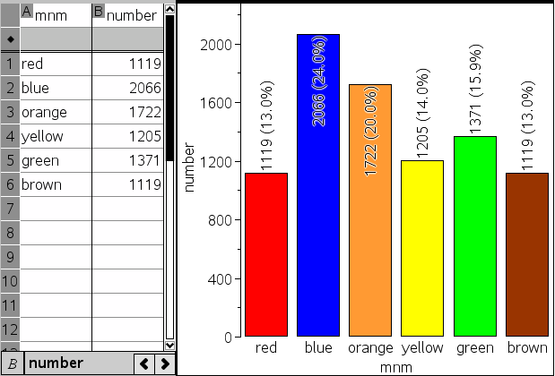
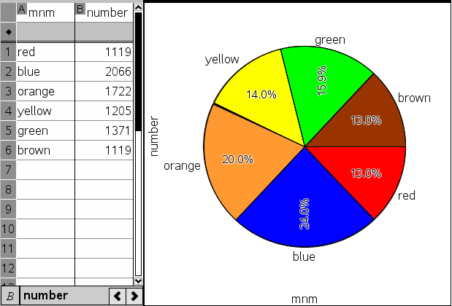
Categorical Data Improvements
Data Exploration
Label All

Slide 6
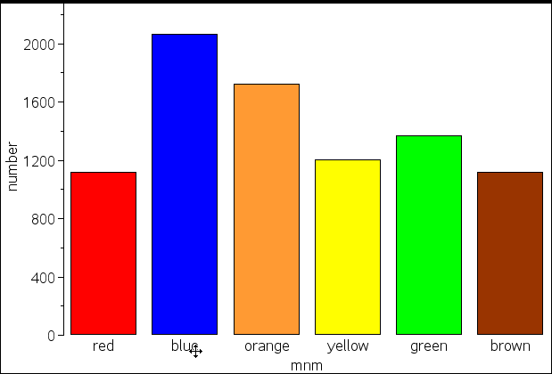
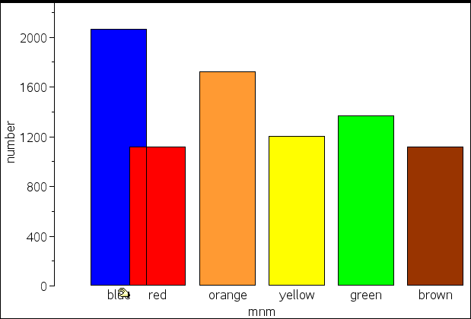
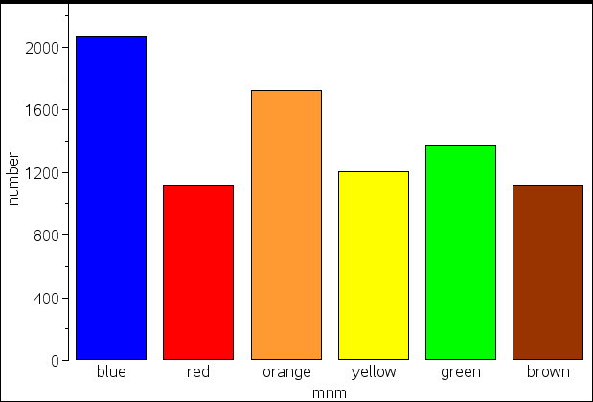
Categorical Data Improvements
Data Exploration
Drag Categories
User can change the order of categories by dragging. For dot , bar, and pie charts and plots split by category.
Dragging has no affect on the list
Drag Label

Slide 7
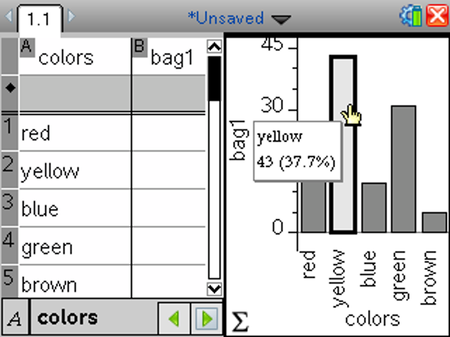
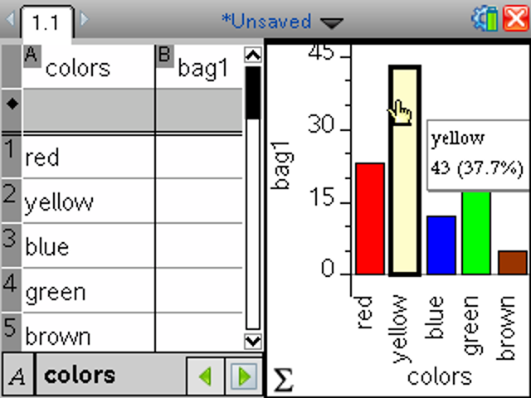
Categorical Data Improvements
Data Exploration
Selection Indication
Selection will be indicated with a bold outline – dot/bar/wedge.
Default for categories will be grey.
User can add color.

Slide 8
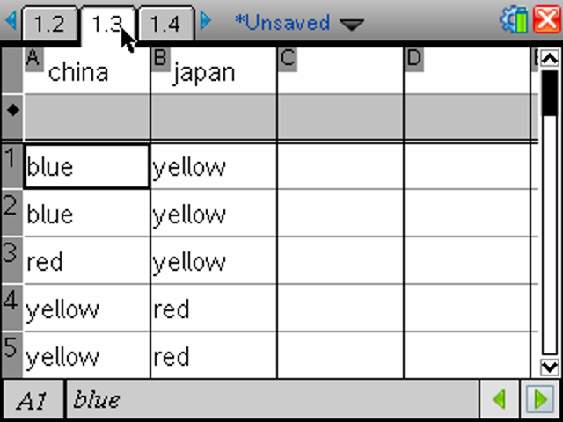
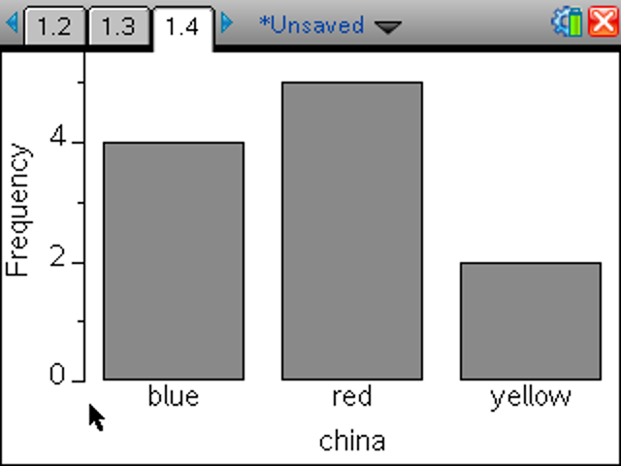
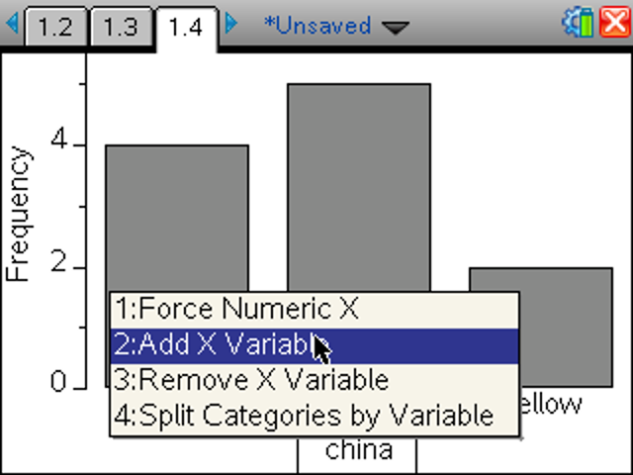
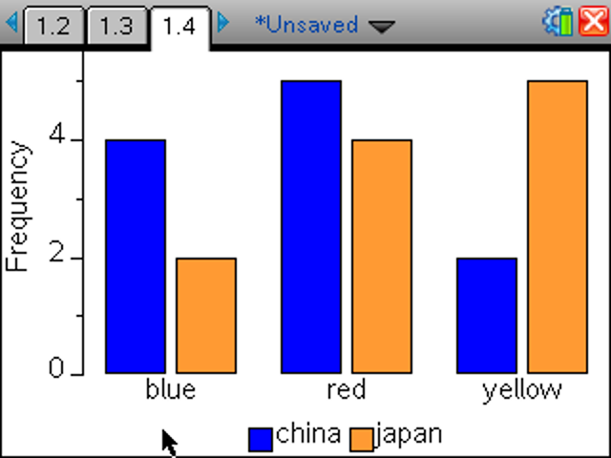
Categorical Data Improvements
Data Exploration/Statistics
Case Data
Default for categories will be grey.
Height of bars automatically calculated.
When it makes sense color is automatically added.

Slide 9
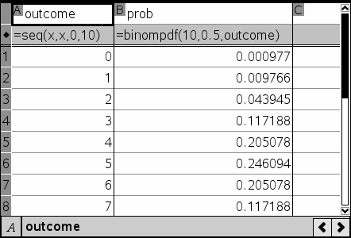
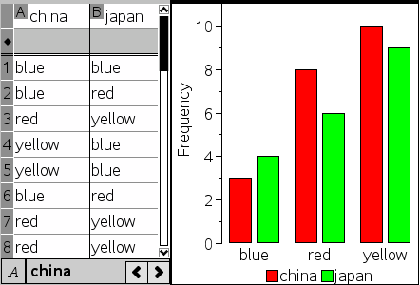
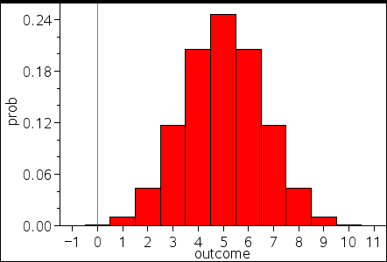
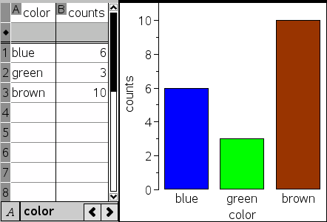
Categorical Data Improvements
Data Exploration
Summary Plots
Height of bars in separate list
Data Exploration
Case Data
Height of bars automatically calculated

Slide 10
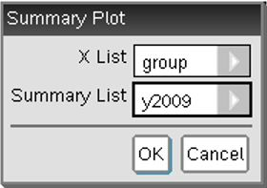
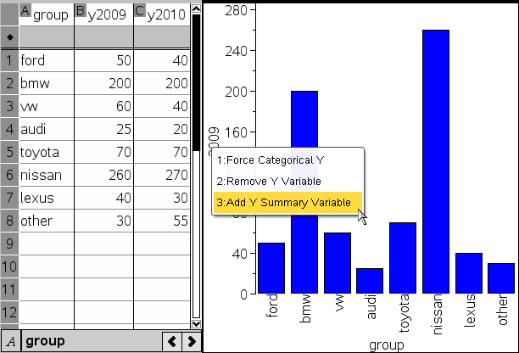
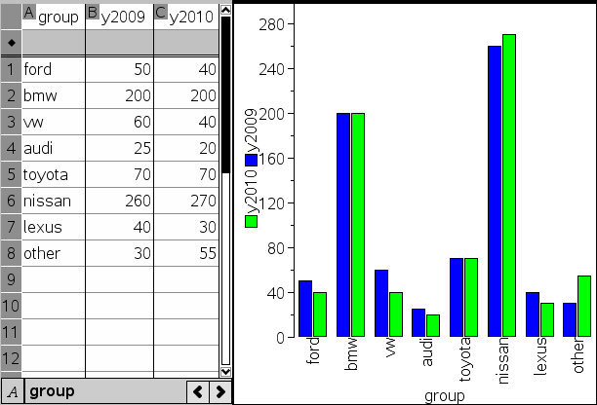
Categorical Data Improvements
Data Exploration
Summary Plots
Frequency plots – Probability distributions – Comparative Bar Charts
Adding

Slide 11
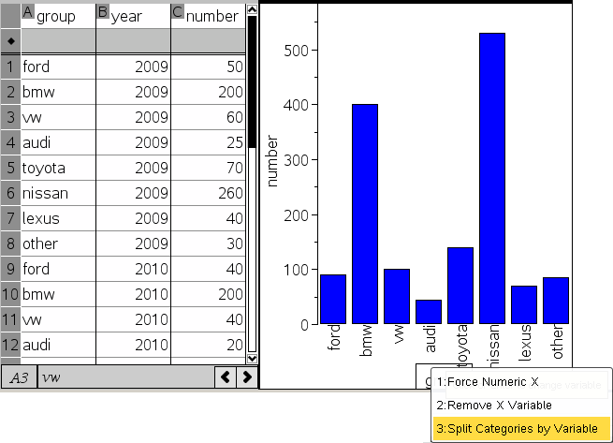
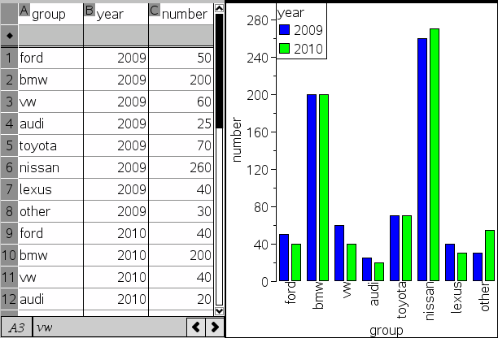

Categorical Data Improvements
Data Exploration
Summary Plots
Frequency plots – Probability distributions – Comparative Bar Charts
Splitting

Slide 12
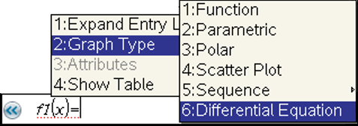
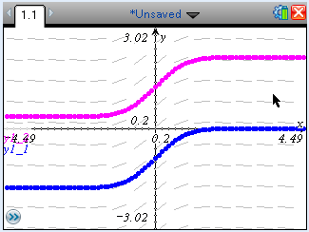
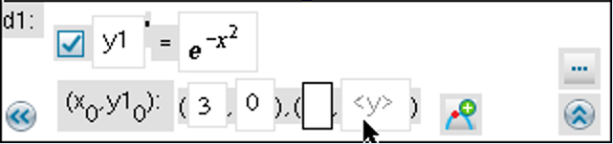
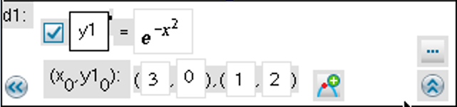
Differential Equations Graphing
First-order ordinary differential equations
One or more particular solution curves
1 initial condition yields 1 particular solution curve passing through that I.C.
additional initial condition yields additional particular solution curve
drag initial condition(s) to dynamically update particular solution curve(s)

Slide 13
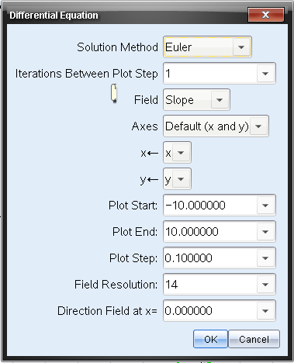
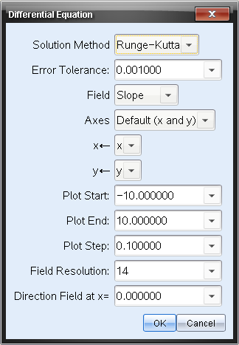
Differential Equations Graphing
First-order ordinary differential equations
Methods: Euler & Runge Kutta
Fields: Slope, Direction or None

Slide 14
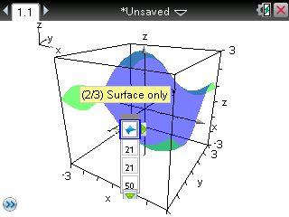
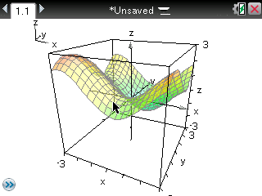
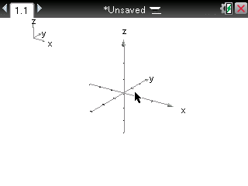
3D Graphing
Expressions of the form z(x, y)
View and explore the result in three-dimensional space. The initial solution is limited to 3D surface plotting.
Disabled by Press-to-Test.
Can plot more than one function in a problem. Allows for dynamic changes using sliders

Slide 15
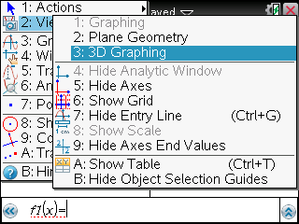
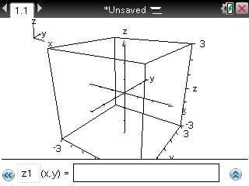
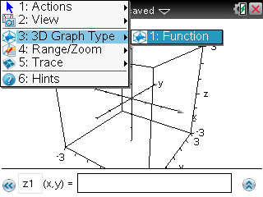
3D Graphing
Accessing 3D Graphing
  Add Graphs application/page and select the 3D Graphing View option
    3D Graphing is a separate environment and switching between 3D and 2D graphing and Plane Geometry is similar to switching from Graphing to Plane Geometry View: no objects carry over between the environments.
  Once in 3D Graphing View, the menus change to 3D menus, for example:
    “Graph Type” Menu changes to “3D Graph Type Menu
    Menus are changed to 3D specific Menu Items
Notes:
1) Start the desktop version
2) On the Welcome Screen, click on "Graphs"
3) Click on "2:View"
4) Click on "3:3D Graphing"
5) Click on "1:Action"
6) Click on "B:Time Variable Setup"
7) Set the Speed to 1
8) Set the Profile to Monotonic
9) Click on "OK"
10) Click on "3:3D Graphing"
11) Click on "1:Function"
12) Type in the function: sin(x+timevar)+sin(y+timevar*0.87)+sin(timevar*1.11)
13) Click on "OK"
14) You should see a surface that looks kind of like ocean waves.

Slide 16
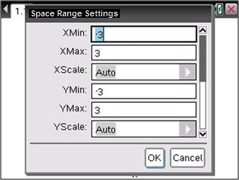
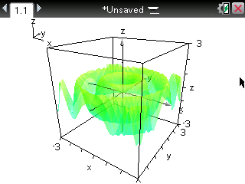
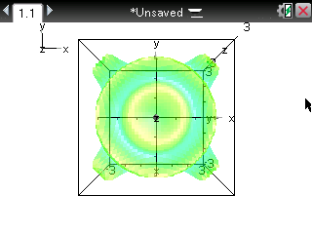
3D Graphing
3D Graphing
Space Range Settings (see pictures above)
Zoom
Animation
  Manual Animation, via cursor keys:
    Press the left and right cursor keys to rotate the graph horizontally.
    Press the up and down cursor keys to rotate the graph vertically
  Automatic Rotation
  Press x, y, z to view the graph along the x axis, the y axis, the z axis and to return to the original orientation
Sliders: Change the slider value to see the graph change accordingly.

Slide 17
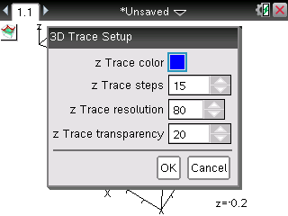
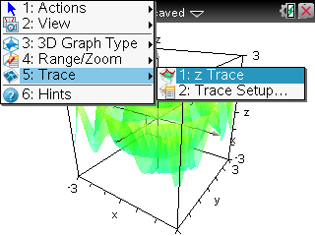
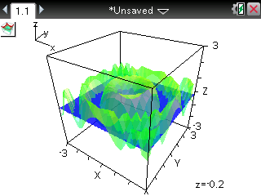
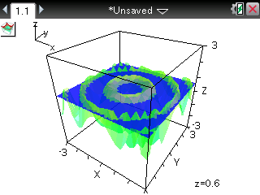
3D Graphing
3D Graphing
Trace Options
  zTrace
  Trace Setup

