Slide 1
GEAR UP CORE Teacher Academy
Chemistry
Workshop #43354
November 7th , 2014

Slide 2
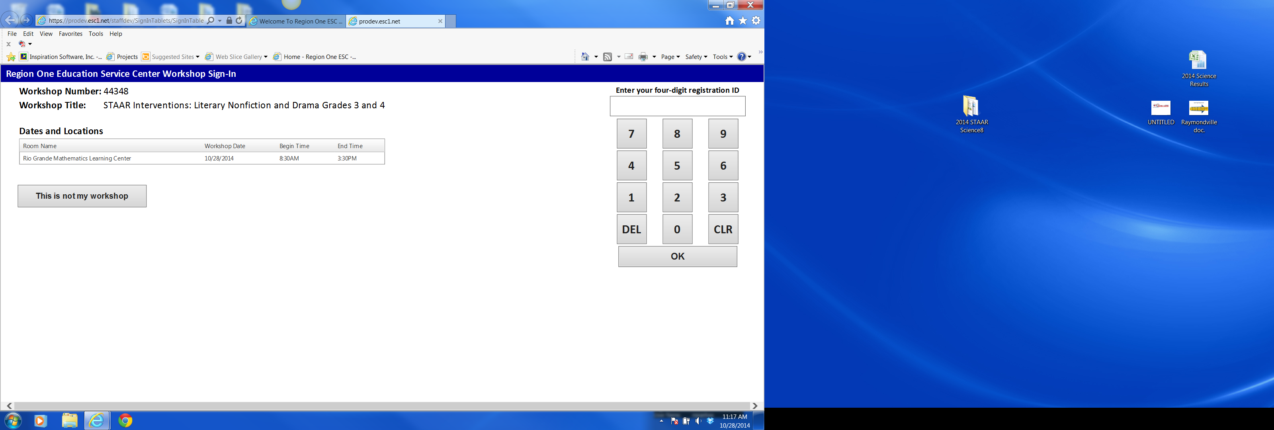
Welcome Back!
Everyone signed in?
43354
Chemistry GEAR UP Core

Slide 3
Welcome
Purpose – focus on instructional strategies utilizing TI Nspire CX technology that will help prepare GEAR UP cohort students for college and career readiness.

Slide 4
Friday’s Agenda
Sharing Best Practices
  Lesson/Activity Sharing Time
Understanding the Colorimeter
CSI in the Operating Room
Rate of Combustion of Parafin
  Candle Burning Lab
Kinetics and the Fading of a Blue Solution
Kinetics and the Decomposition of H2O2
Question and Answer

Slide 5
Do’s and….
Do
ask questions
make suggestions
share with others
Don’t
hold back
limit yourself

Slide 6
Sharing Best Practices
At your table…
Share your best classroom experience with your students and the Nspire.
With the whole group…
Share some of the examples you heard from others that you would like to try with your students.
Now Let’s Do Some Chemistry!!!!

Slide 7
November Homework
Create a tns File
Using chemical equation tool
Give word equation
Ask for skeleton equation (self check)
Then use balanced equation tool
Ask mole to mole ratio questions

Slide 8
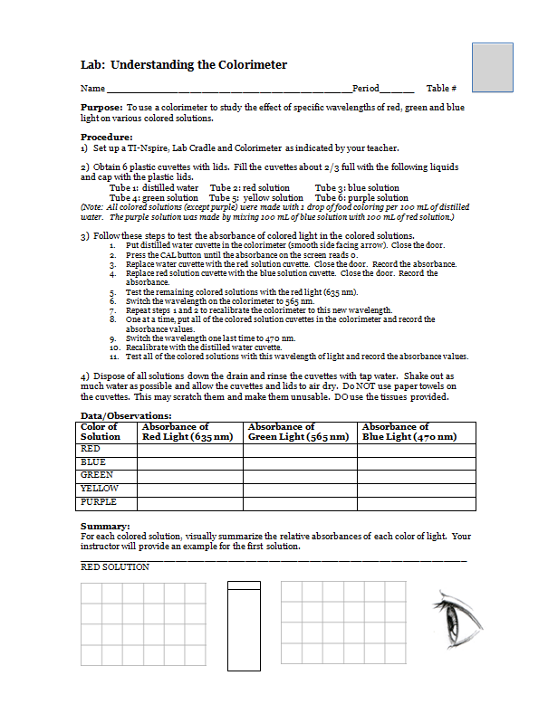
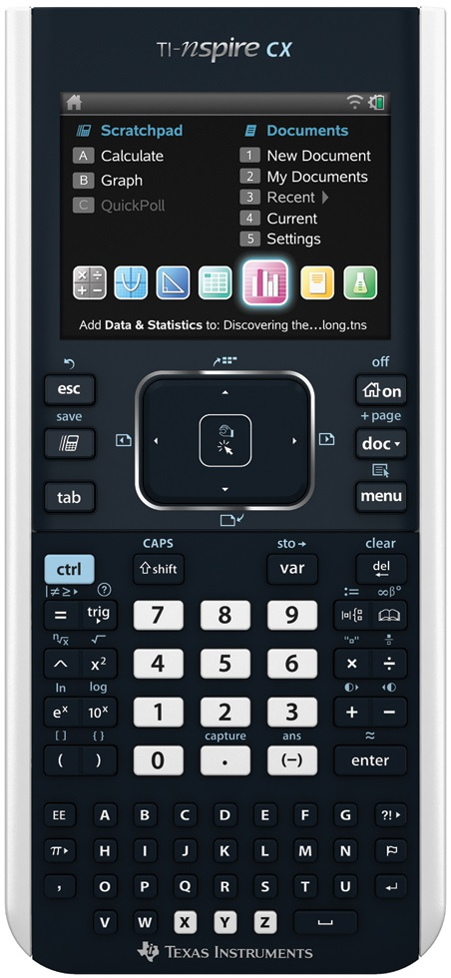
Color and the Colorimeter

Slide 10
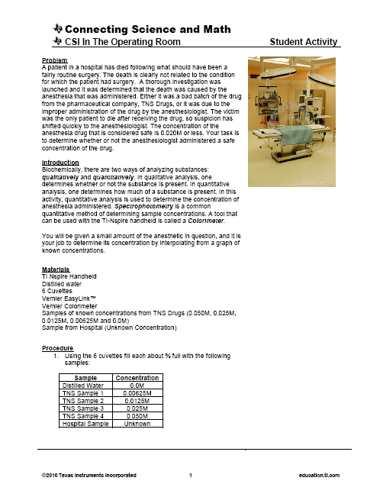
Connecting Science and Math
CSI in the Operating Room

Slide 12
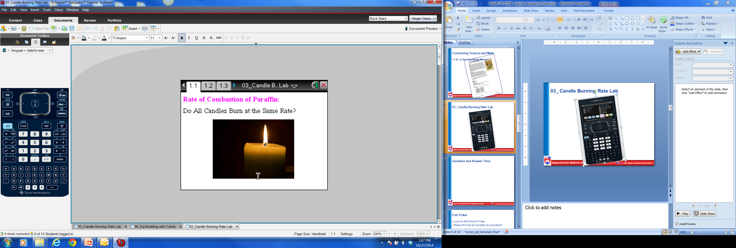
03_ Candle Burning Rate Lab

Slide 14
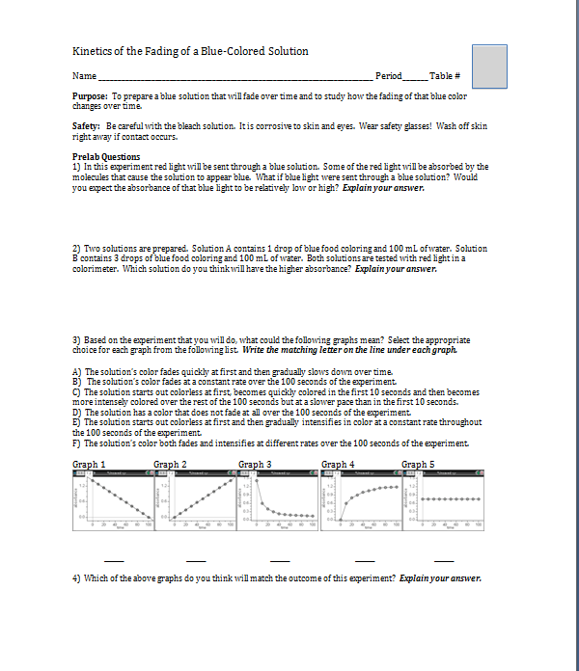
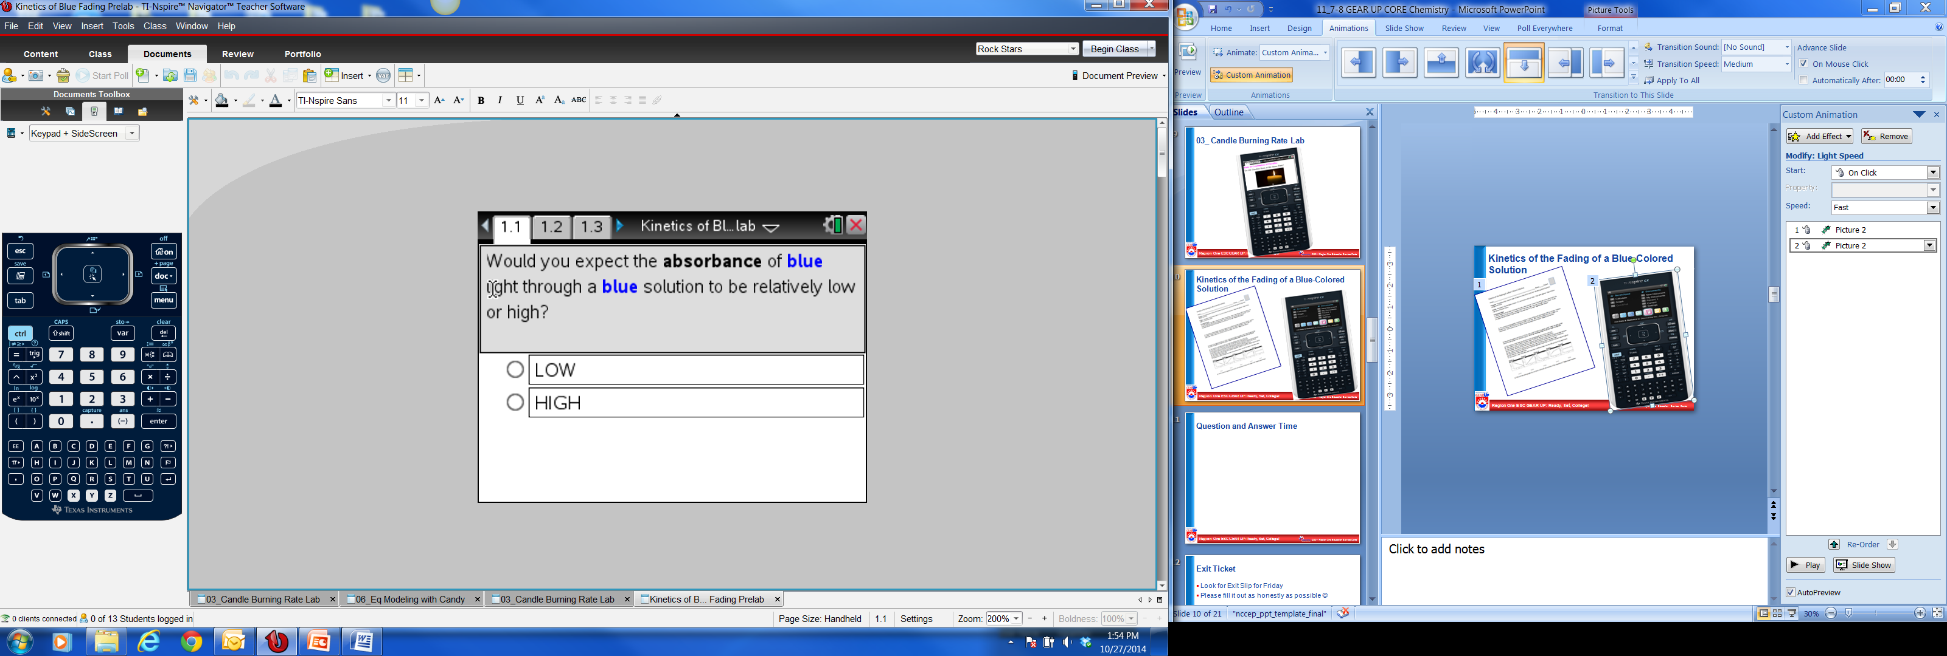
Kinetics of the Fading of a Blue-Colored Solution

Slide 16
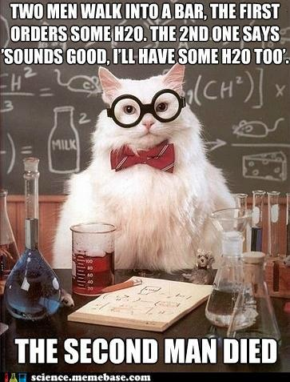
H2O2- Friend or Foe

Slide 17
Question and Answer Time

Slide 18
Exit Ticket
Look for Exit Slip for Friday
Please fill it out as honestly as possible ☺

Slide 19
TI Education Website
www.education.ti.com
Point to Activities tab
Click on Science Nspired
Explore…
Click on Learn More
Product Tutorials

Slide 20
Remember to sign out
43354
Chemistry GEAR UP Core
Have a Great Afternoon
See you tomorrow!

Slide 21
GEAR UP CORE Teacher Academy
Chemistry
Workshop #43354
November 8th, 2014

Slide 22
Welcome Back!
Everyone signed in?
43354
Chemistry GEAR UP Core

Slide 23
Saturday’s Agenda
Exit Ticket Review
Equilibrium- A Matter of Balance
    Modeling Equilibrium with Candy
LeChantelier’s Principle Simulation
A Good Cold Pack
Acids and Bases- Data Quest Activity
Reaction Stoichiometry- Guided Inquiry
Lemon “Juice”

Slide 24
Exit Ticket Review

Slide 25
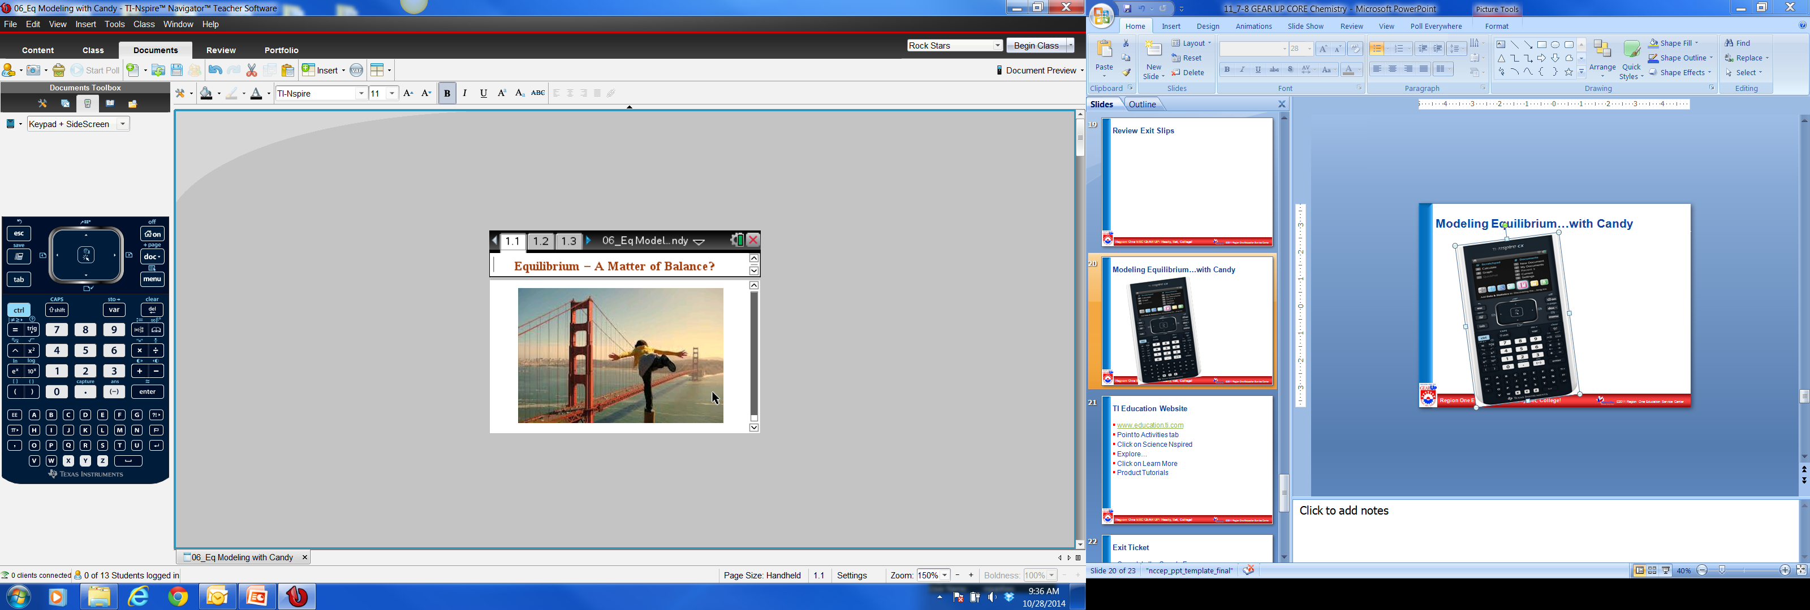
Modeling Equilibrium…with Candy
Nspire
Activity

Slide 27
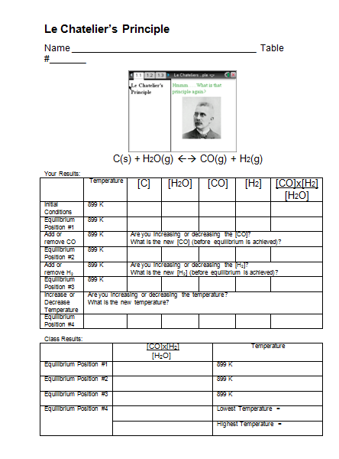
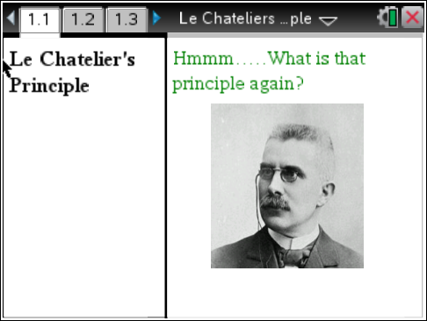
Le Chantelier’s Principle

Slide 28
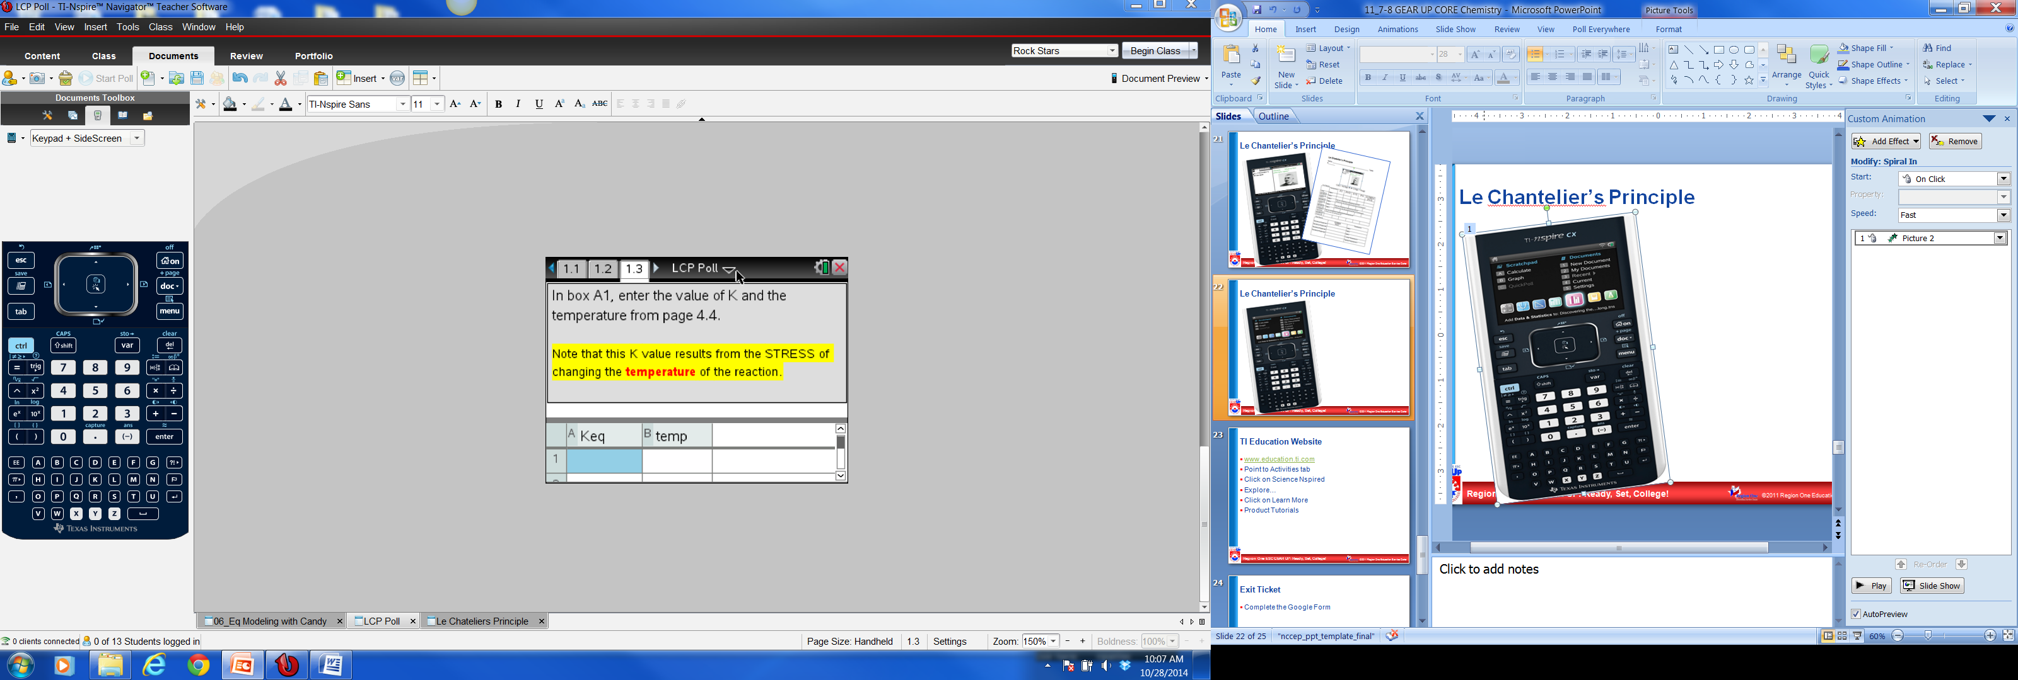
Le Chantelier’s Principle –LCP Poll TNS

Slide 30
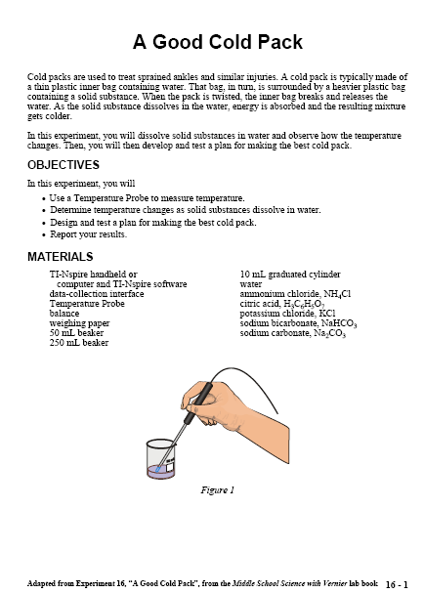
A Good Cold Pack

Slide 31
GEAR UP Survey
Welcome back from lunch
Before we begin please go to the link below
https://www.surveymonkey.com/s/ScienceCore
And complete the survey

Slide 32
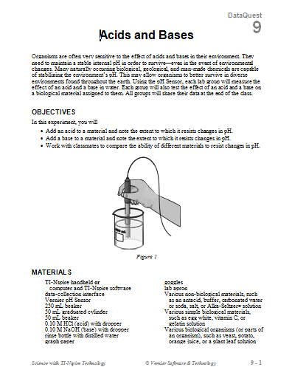
Acids and Bases

Slide 34
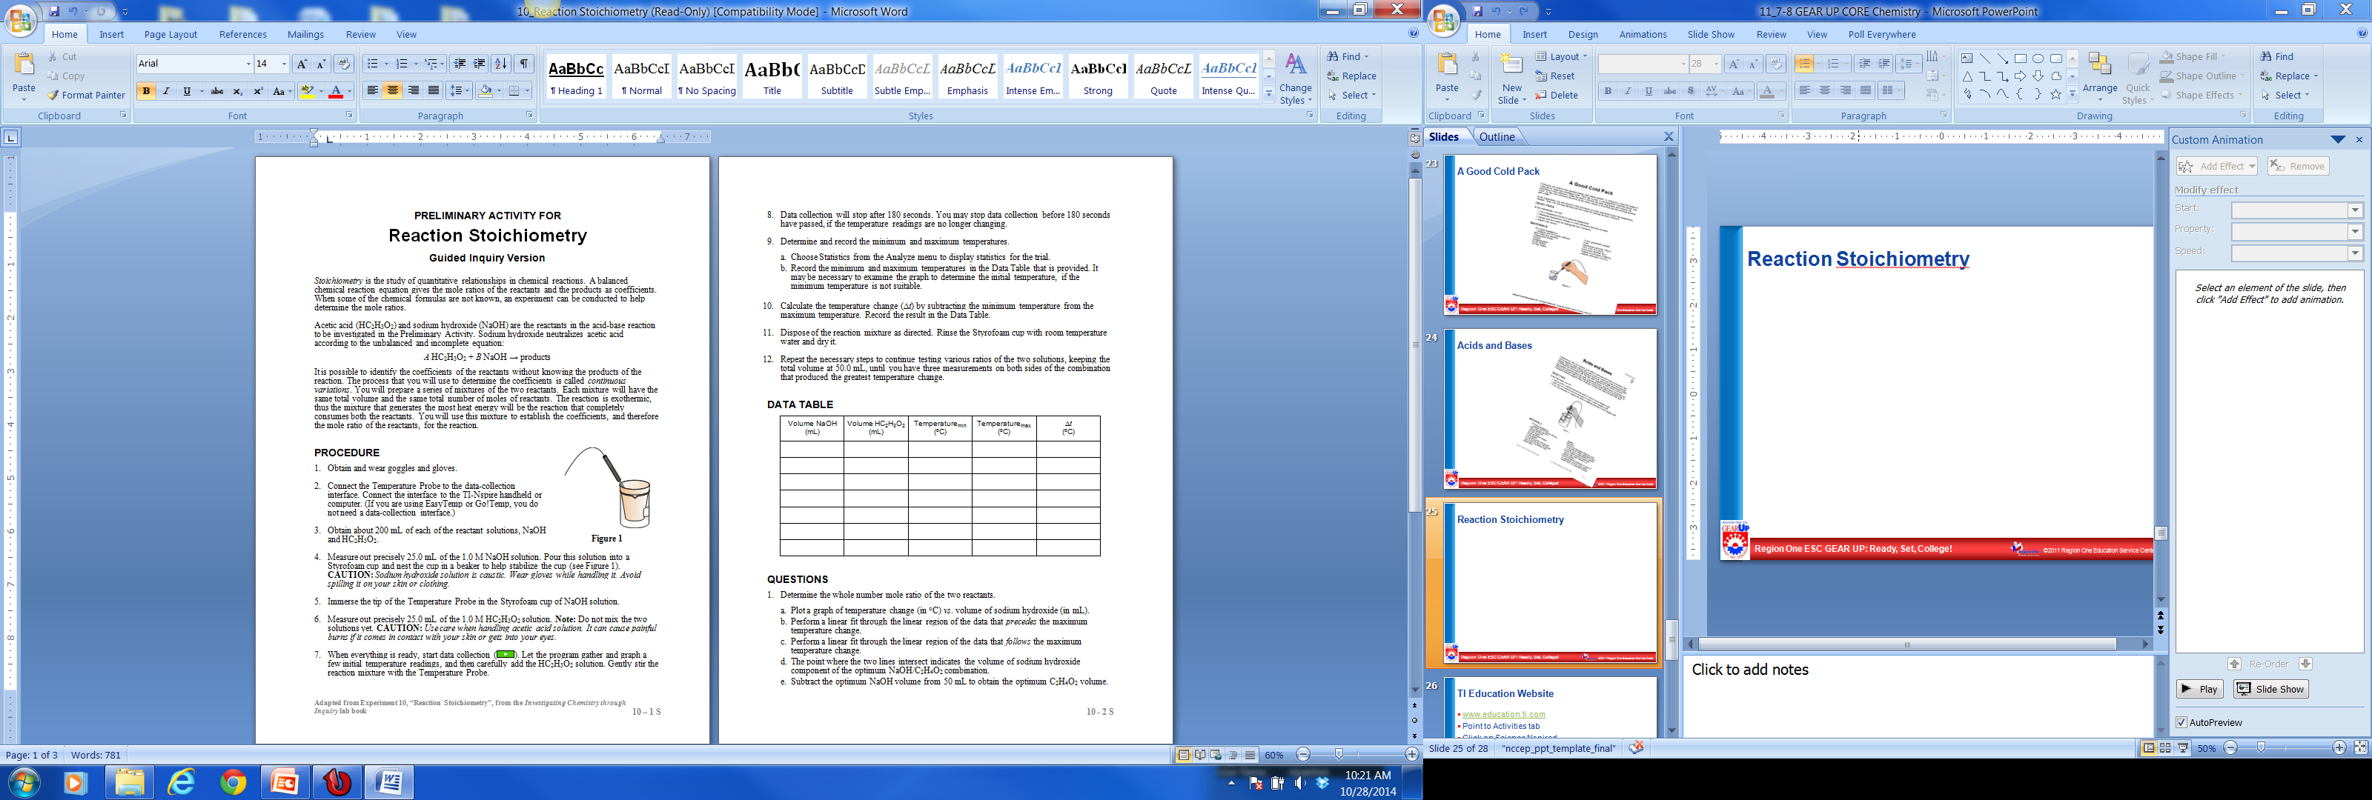
Reaction Stoichiometry

Slide 36
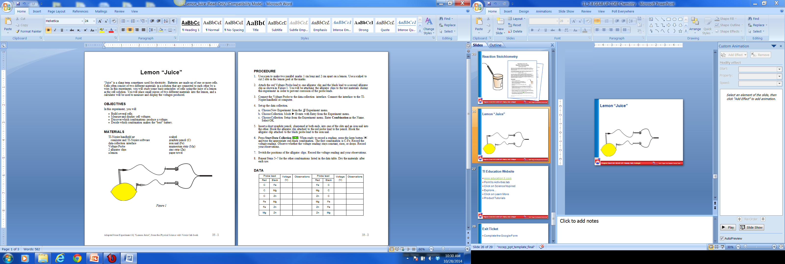
Lemon “Juice”

Slide 37
Exit Ticket
Complete the Google Form
http://goo.gl/LCZbti

Slide 38
TI Education Website
www.education.ti.com
Point to Activities tab
Click on Science Nspired
Explore…
Click on Learn More
Product Tutorials

Slide 39
Remember to sign out
43354
Chemistry GEAR UP Core
Have a Great Afternoon!

