Slide 1
TI-Nspire™ 3.9
What’ New

Slide 2
Agenda
Introduction
Release Overview:
  Scope
    Supported Configurations
    “Must-Know” Information
    Hands-On Activity
    Question & Answer Session
    Enhancement Requests

Slide 3
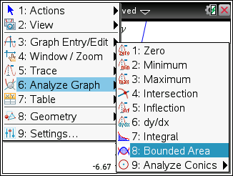
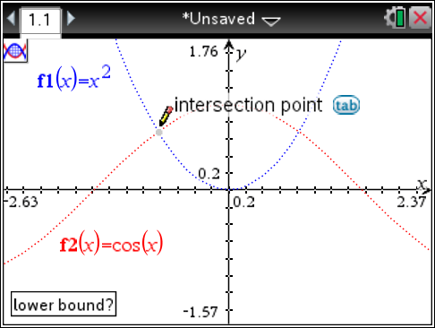
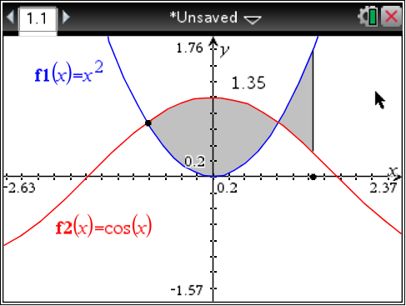
TI-Nspire 3.9 Overview - Scope
TI-Nspire™ Navigator™ - Help Backing Up Class Records
Graphs - Bounded Area: Calculate and highlight the area between two graphed functions.
    Find the area between two functions with respect to x or equations in the form y=
    Bounds can be specified via precise entry or by selection (free or at the curves intersection points).
    There are no Press-to-Test restrictions.
Notes:
Find the area between two functions with respect to x or equations in the form y=
Bounds can be specified via precise entry or by selection (free or at the curves intersection points).
There are no Press-to-Test restrictions.

Slide 4
TI-Nspire 3.9 Overview - Scope
Data & Statistics - Visual Improvements
  Shaded the area that shows the axis labels and values to distinguish it from the plot area.
  Added grid lines and changed the default color of plots.
  The cycle of colors used to show multiple plots is now similar to the cycle used in pie charts.
PublishView - New Video Formats
  Supports FLV container with VP6 video and MP3 audio.
  Supports MP4 (MPEG-4 multimedia container) with H264/AVC (Advanced Video Coding) video compression and AAC audio.
Data Collection - Easier Management of Data Sets
  Clicking the Data Set Selector (near the top of the Detail View) expands the list of data sets into a scrollable list.
  The list lets makes it easy to delete data sets or select them for visual comparison.

Slide 5
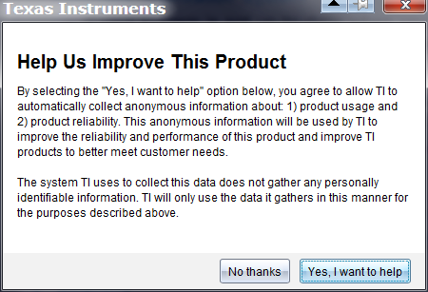
TI-Nspire 3.9 Overview – Scope
Automatic Notification System
  If your system is not up-to-date when you launch the software, you receive a notification with a link to learn more about the new release.
  You can switch the notification system on or off from the Help menu.
Analytics for Product Improvement
  Usage and product reliability data is collected when users choose to help improve the TI-Nspire products. The data collected is anonymous .

Slide 6
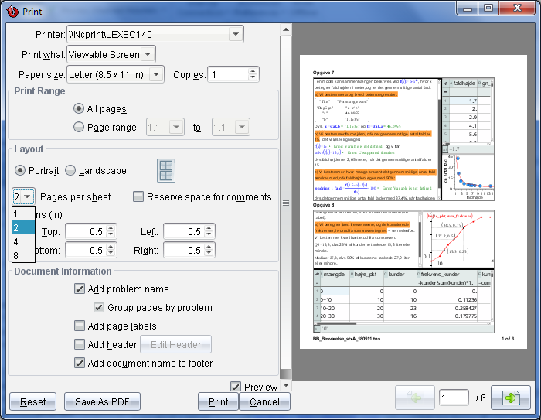
TI-Nspire 3.9 Overview
Scope
Printing Improvements
  Added Save as PDF to make it easy to share TI-Nspire™ and PublishView™ documents.
  Reduced the default margins to improve printed text size, and changed default number of pages per sheet to 2.
  Hide or unhide page labels independent of problem name.
Notes:
Default margins have been reduced to improve printed text size, and default number of pages per sheet is now 2.
You now have the ability to hide or unhide page labels independent of problem name.
Added Save as PDF to make it easy to share TI-Nspire™ and PublishView™ documents.

Slide 7
Mac Updates
  All MacOS desktop applications now use Oracle’s Java
  Earlier versions used Apple’s Java which is being discontinued
  All MacOS desktop applications are now 64-bit
  Windows applications remain as 32-bit applications
  No user facing impact due to these changes – except better compatibility with future MacOS releases

Slide 8
TI-Nspire 3.9 Overview
Defects found in the Field and fixed in 3.9
9 Math & Graphing
  Wrong answers with fMax, solve and limit
  Resource exhaustions and long calculations
  Discontinuous graphs falsely displayed as continuous
  Scatter plots not dynamically updating in some documents
4 Stability & Performance
  Software does not launch for some customers
  Software responds very slow after upgrading to 3.6
5 Portfolio & Review Workspaces
  Questions not graded properly in some special cases
  Student responses not displayed or saved in the wrong portfolio
1 Authoring
  L&S column widths changed upon save/reopen
12 Other

Slide 9
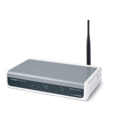

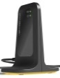
TI-Nspire 3.9 Overview
Compatibility – Wireless Clients with Access Points
 | TI Navigator™ Access Point | TI-Nspire™ Navigator™ Access Point | TI-Nspire™ CX Navigator™ Access Point (
Wireless cradle (with USB port) | Yes | No | No
Wireless cradle (without USB port) | Yes | Yes | No
TI-Nspire Network Adapter | Yes | Yes | Yes (2.4 GHz only)
TI-Nspire™ CX Wireless Network Adapter (v2) | No | Yes (2.4 GHz only) | Yes 2.4 and 5GHz
What this means:
The new TI-Nspire CX Navigator Access Point can be used in a class of mixed wireless network adapters when it is operating on the 2.4 GHz band.
The new access point cannot support a mixed classroom of wireless cradles and network adapters.
To take advantage of the 5GHz capabilities the user must have both the TI-Nspire CX Navigator Access Point and TI-Nspire CX Wireless Network Adapters (v2).

Slide 10
TI-Nspire 3.9 Overview
Compatibility - Summary
 | 3.9 | TI-Navigator Access Point | TI-Nspire Navigator Access Point (KAPNG) | TI-Nspire CX Navigator Access Point (LAP5)
TI-Navigator Access Point | Yes
TI-Nspire Navigator Access Point (KAPNG) | Yes
TI-Nspire CX Navigator Access Point (LAP5) | Yes
Wireless cradle (with USB port) | Yes | Yes | No | No
Wireless cradle (without USB port) | Yes | Yes | Yes | No
TI-Nspire Network Adapter | Yes | Yes | Yes | Yes
TI-Nspire CX Wireless Network Adapter (v2) | Yes | No | Yes | Yes
Software and handhelds must be updated to 3.9 for wireless connectivity to work.

Slide 11


TI-Nspire 3.9 Overview
Supported Desktop Configurations
3.9
PC
  Windows 8.1
  Windows 7
  Windows XP
Mac
  OS X 10.9.2
  OS X 10.8.5
  OS X 10.7.5
3.6 Comparison
PC
  Windows 8
  Windows 7
  Windows XP
Mac
  OS X 10.8.4
  OS X 10.7.5
  OS X 10.6.8

Slide 12
TI-Nspire 3.9 Overview
“Must Know” Information
TI-Nspire™ Handheld OS
  To increase security, handheld OS downgrades from 3.9 to previous versions are blocked. Handhelds updated to 3.9 can no longer be used with versions of TI-Nspire™ Navigator™ software earlier than 3.9. You must update your TI-Nspire™ Navigator™ software to 3.9.
TI-Nspire™ Navigator™ Teacher Software for Handhelds
  Handhelds should be updated before updating the desktop software

Slide 13
Set Up a TI-Nspire™ Navigator™ System

Slide 14
Questions?

